Slide 1
CONDITIONAL STATEMENTS
Lecturer: Nadia Binte Asif

Slide 2
Intro
To make decisions based on conditions
Also known as branching
Is executed sequentially
Affects the result of the surrounding block
Applied
if statement
if…else statement

Slide 3
C if Statement
START
if (condition) {
/* code to be executed if the condition is true */
}
Condition
YES
Statements
NO
REST OF THE CODE

Slide 4
Checking for a positive number
#include<stdio.h>
void main(){
int a;
printf("Enter any number: \n");
scanf("%d", &a);
if( a > 0){
printf("Entered number %d is positive \n");
}
}

Slide 5
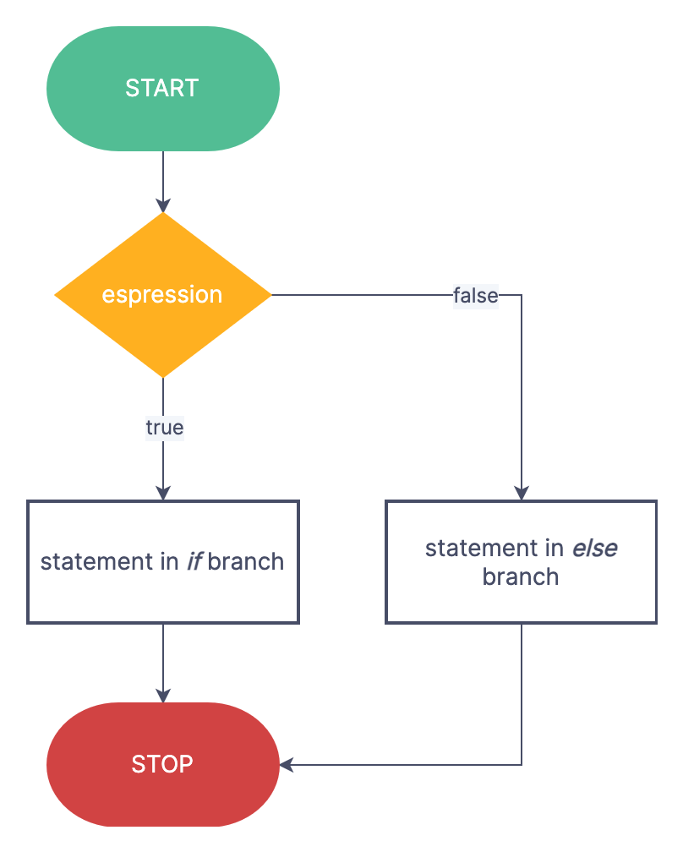
C if…else Statement
if (condition) {
/* code to be executed if the condition is true */
}
else{
/* code to be executed if the condition is false */
}

Slide 6
Checking for a positive number or negative number
#include<stdio.h>
void main(){
int a;
printf("Enter any number: \n");
scanf("%d", &a);
if( a > 0){
printf("Entered number %d is positive \n",a);
}
else{
printf(“Entered number %d is negative \n”,a);
}
}

Slide 7
C elseif Statement
Also known as if..else ladder
if (test expression1) {
// statement(s)
}
else if(test expression2) {
// statement(s)
}
else if (test expression3) {
// statement(s)
}
else {
// statement(s)
}

Slide 8
// Program to relate two integers using =, > or < symbol
#include <stdio.h>
int main() {
int number1, number2;
printf("Enter two integers: ");
scanf("%d %d", &number1, &number2);
//checks if the two integers are equal.
if(number1 == number2) {
printf("Result: %d = %d",number1,number2);
}
//checks if number1 is greater than number2.
else if (number1 > number2) {
printf("Result: %d > %d", number1, number2);
}
//checks if both test expressions are false
else {
printf("Result: %d < %d",number1, number2);
}
return 0;
}

Slide 9
Problems
Check for leap year
Find the largest number between given three numbers
Check whether a number is divisible by 5 and 11 or not.
Check whether the given number is odd or even
Check the given input for vowel
Input week number and print week day

